Slide 1
Intro to Programming
Class 11, 11 Oct 2015

Slide 2
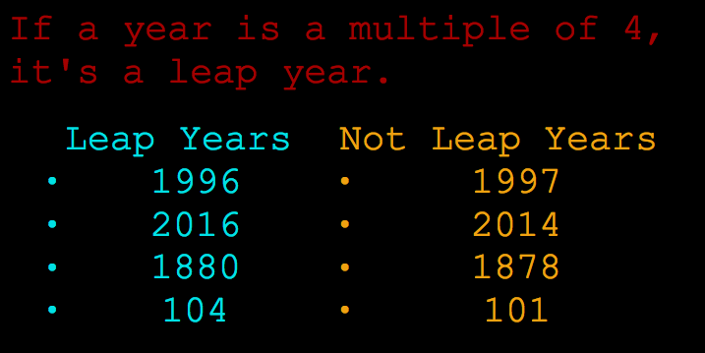
Warm-up
On 1 computer with a partner:
Step 1:
Write a program that determines if a given year is a leap year.

Slide 3
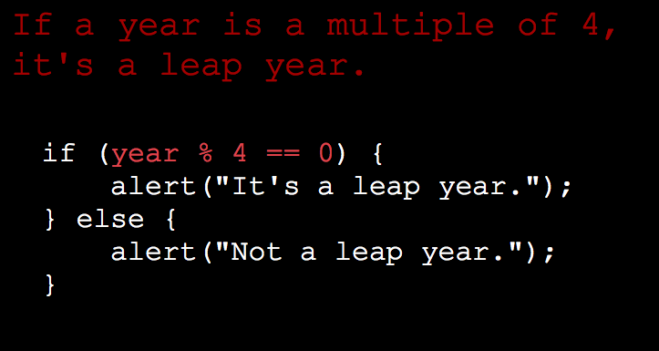
Warm-up

Slide 4
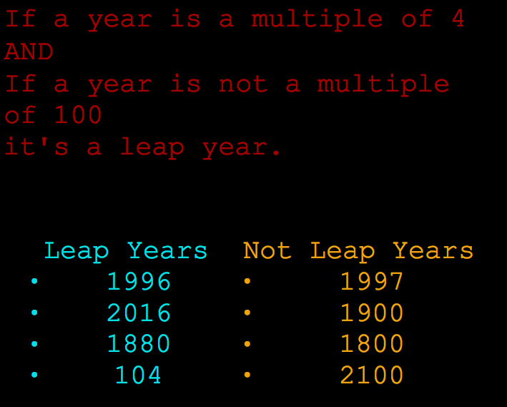
Warm-up
Step 2:

Slide 5
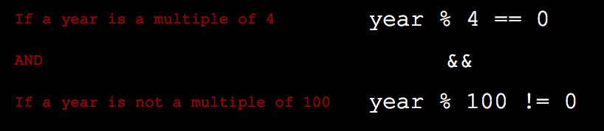
Warm-up

Slide 6
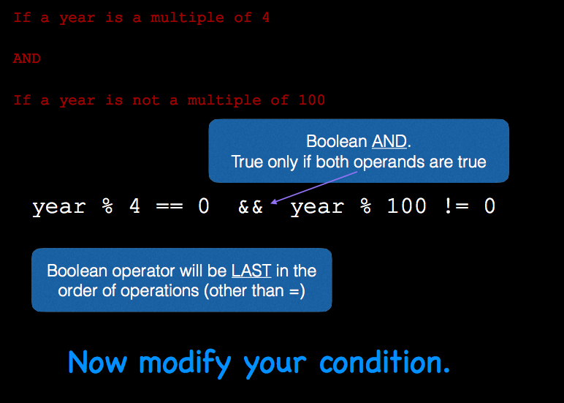
Warm-up

Slide 7
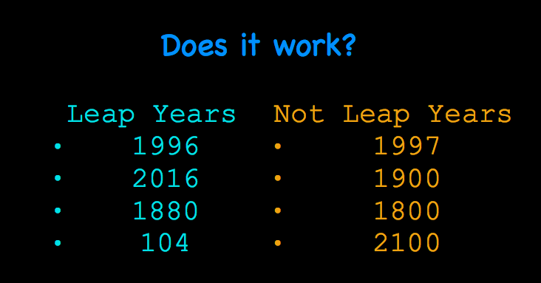
Warm-up

Slide 8
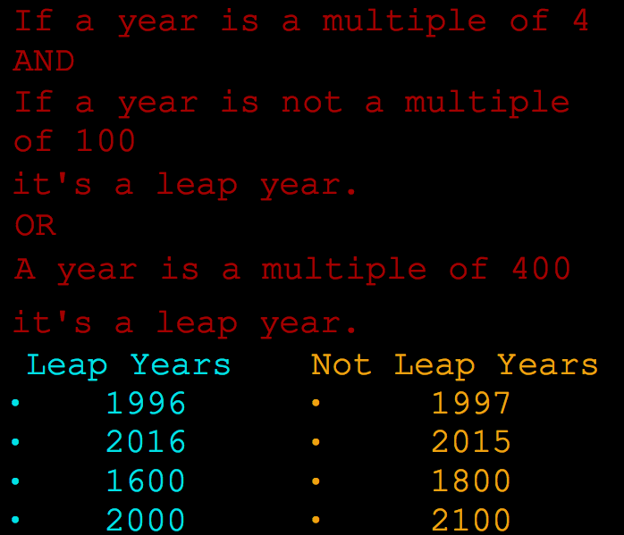
Warm-up
Step 3:

Slide 9
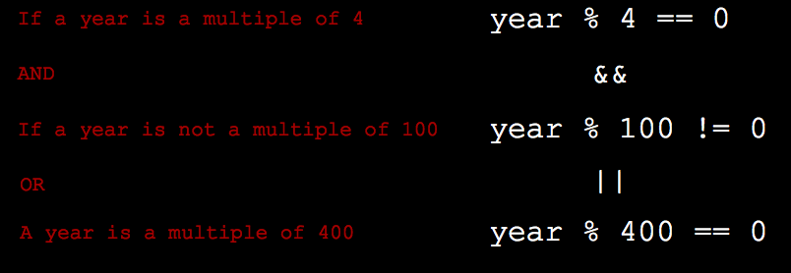
Warm-up

Slide 10
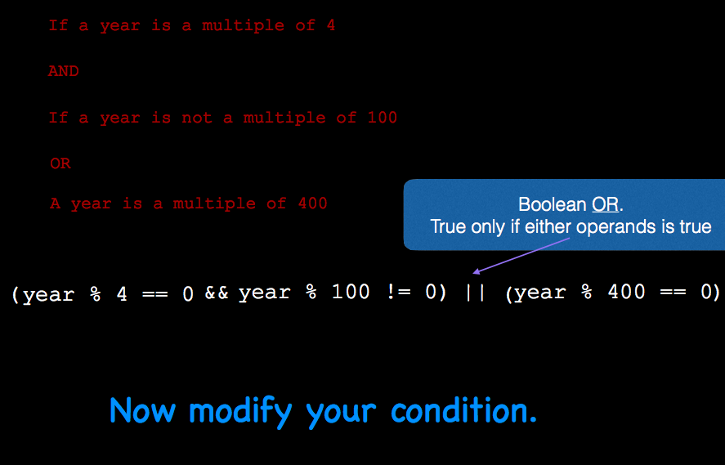
Warm-up

Slide 11
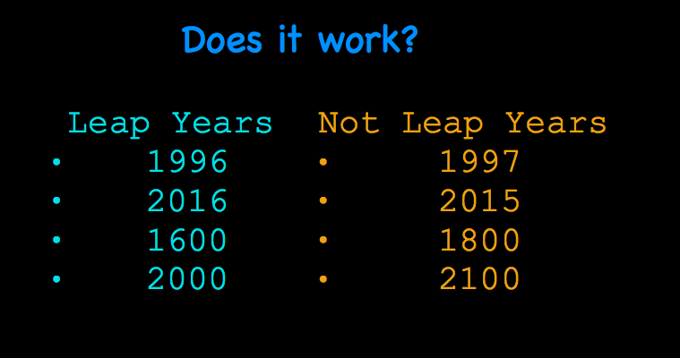
Warm-up

Slide 12
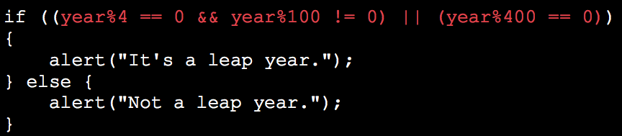
Warm-up

Slide 13
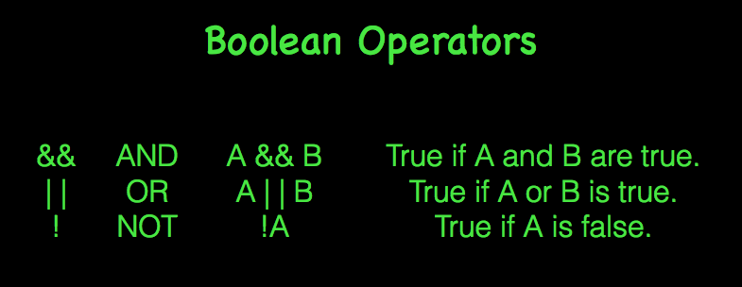

Slide 14
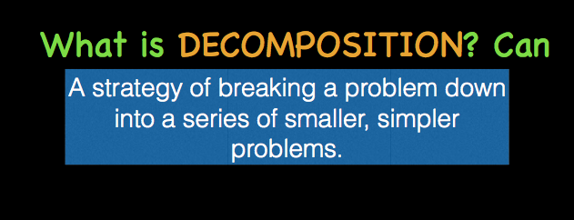

Slide 15
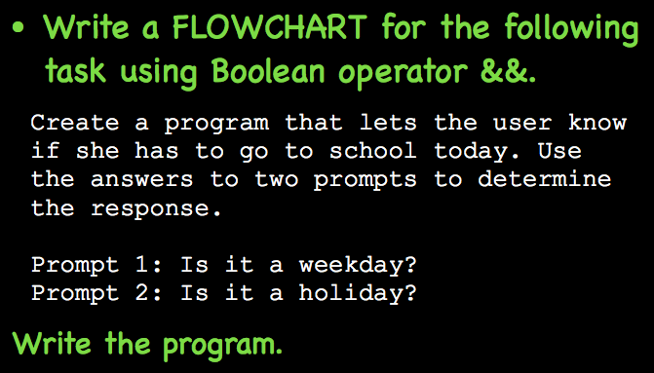
With your partner on 1 computer:

Slide 16
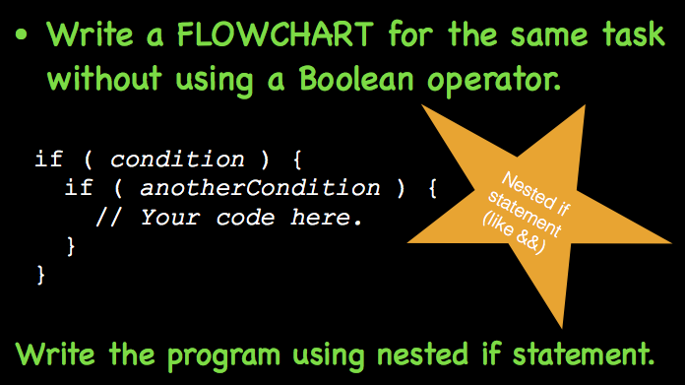
With your partner on 1 computer:

Slide 17


Slide 18
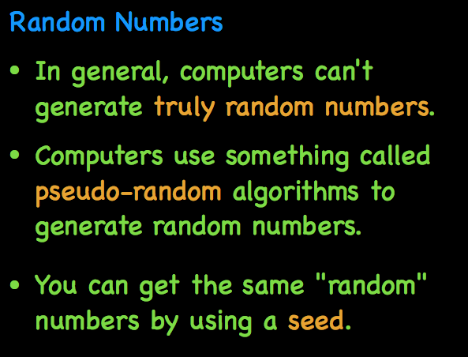

Slide 19

Why would you need a random number in an app?

Slide 20
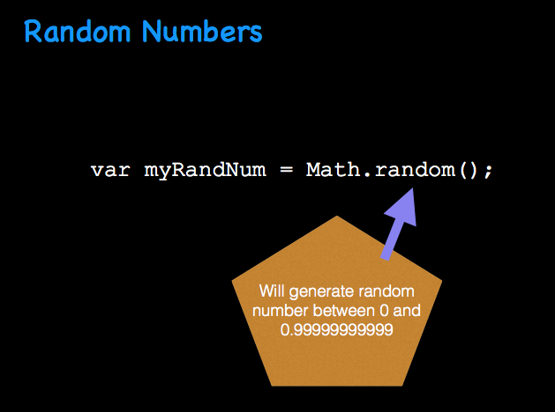

Slide 21
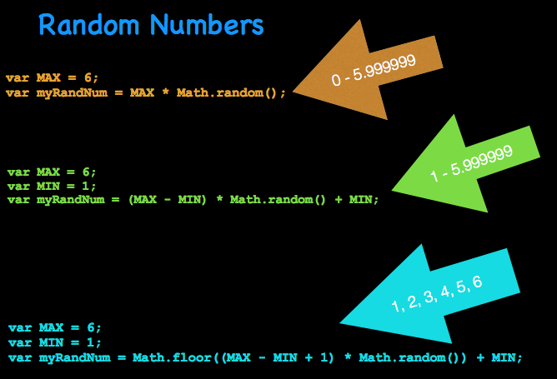

Slide 22
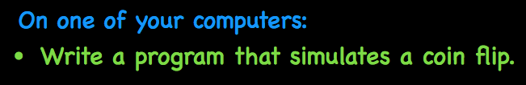

Slide 23
